Slide 1
var title = “State of affairs”;
var info = {
name: “martinChaov”,
foo: “bar”
};

Slide 2
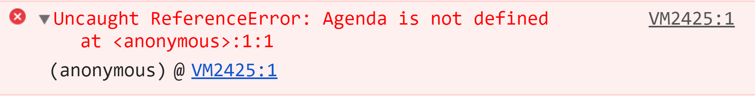
Martin
Chaov

Slide 3
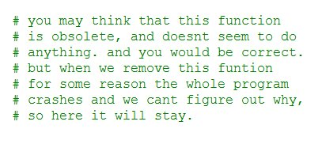

Slide 4
DDD
Notes:
Dijkstra driven development, also known as shortest path to production ... one way or another...

Slide 5


Slide 6
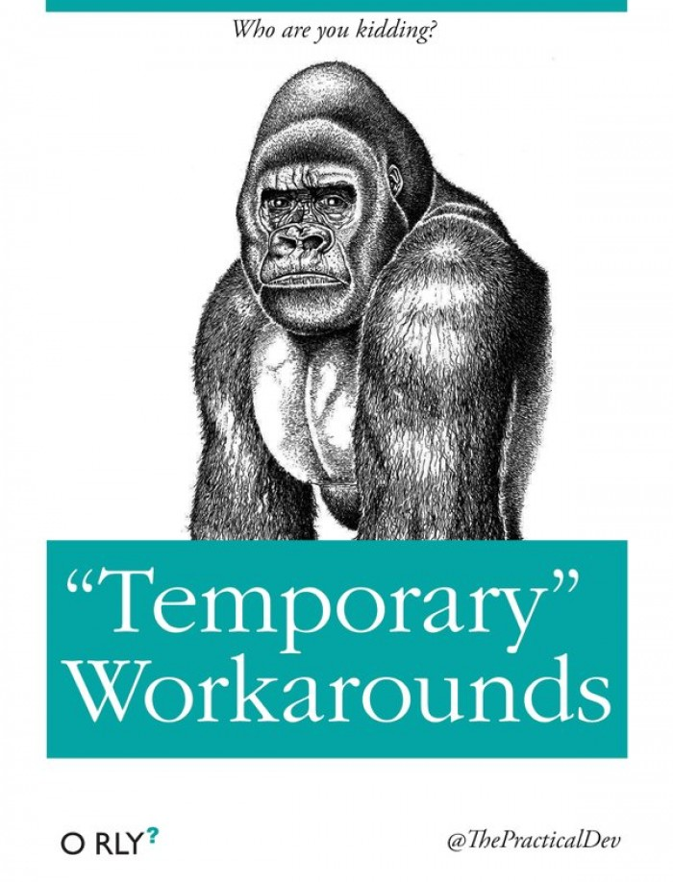

Slide 7
GDD
Notes:
GDD - Google driven development. It is mostly used by noobs, so we aren't going to talk about it much :)

Slide 8


Slide 9
CCP
Notes:
CCP - Cargo cult programming is probably my favorite one so far.
Ritual inclusion of structures…
Copy Paste…
Design patterns
Somebody once told me
Superstition
Cargo cult programming is a style of computer programming characterized by the ritual inclusion of code or program structures that serve no real purpose. Cargo cult programming is typically symptomatic of a programmer not understanding either a bug they were attempting to solve or the apparent solution

Slide 10

Notes:
Using best practices that doesn't apply to your specific case.
Bad developers can write bad code ... good developer are much better at it.

Slide 11

Notes:
Code written by a stranger on the internet is always perfect.
React component class with one HTML element inside

Slide 12
FDD
Notes:
Faith driven development
This is going to be faster
Don’t read docs, infer the API from thin air

Slide 13

Notes:
Faith driven development
This is going to be faster
Don’t read docs, infer the API from thin air

Slide 14
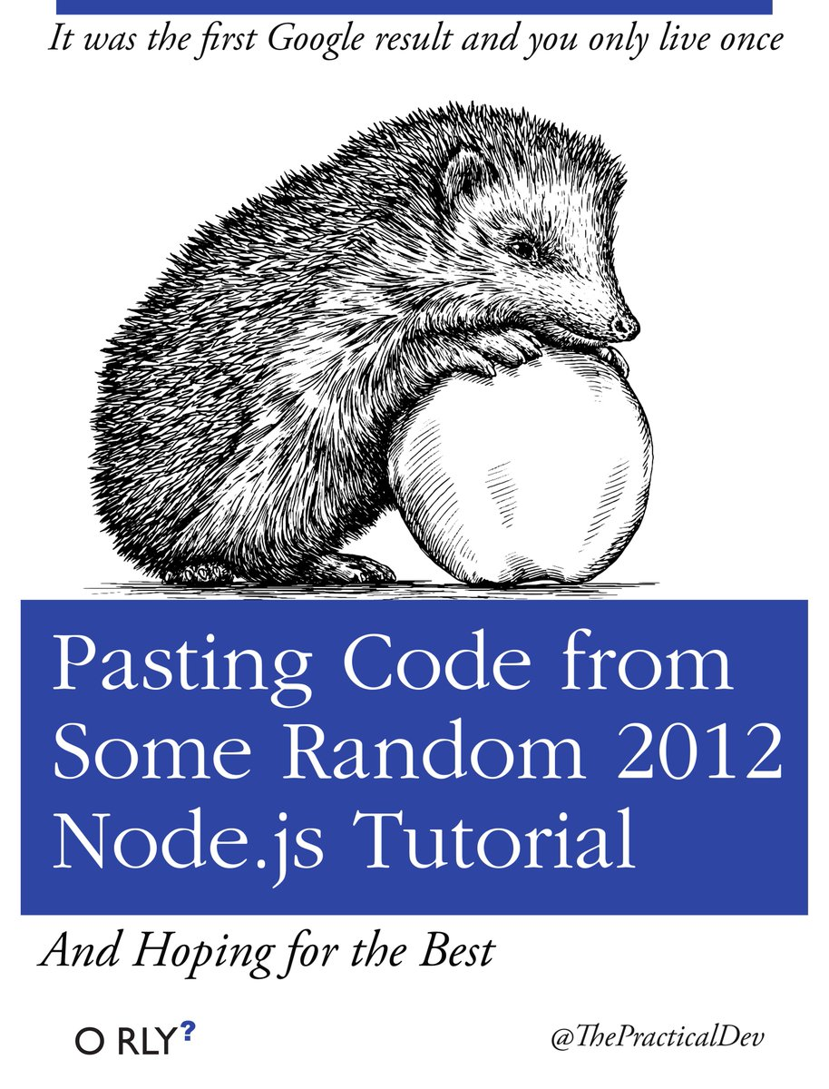
Notes:
Faith driven development
This is going to be faster
Don’t read docs, infer the API from thin air

Slide 15
PCP
Notes:
PCP - Programming by coincidence principle. It comes in two major variations:
- Changing stuff and seein what happens - mainly applied by junior developments. Sometimes they even open up the documentation of the library or framework on the second screen..
- Trying stuff until it works - now this is mainly applied by the more advanced programmers. They believe they understand the language so well, that they can infer APIs out of thin air.

Slide 16
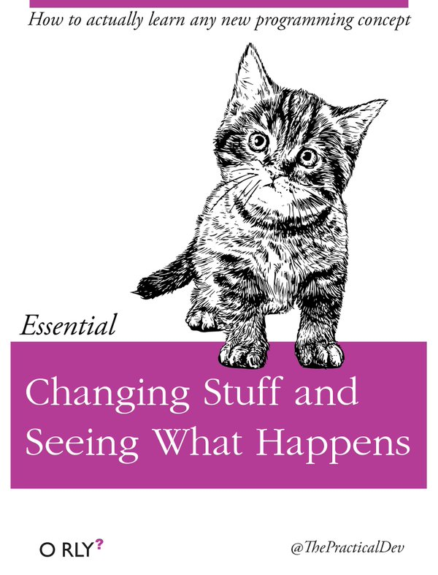
Notes:
PCP - Programming by coincidence principle. It comes in two major variations:
- Changing stuff and seein what happens - mainly applied by junior developments. Sometimes they even open up the documentation of the library or framework on the second screen..

Slide 17
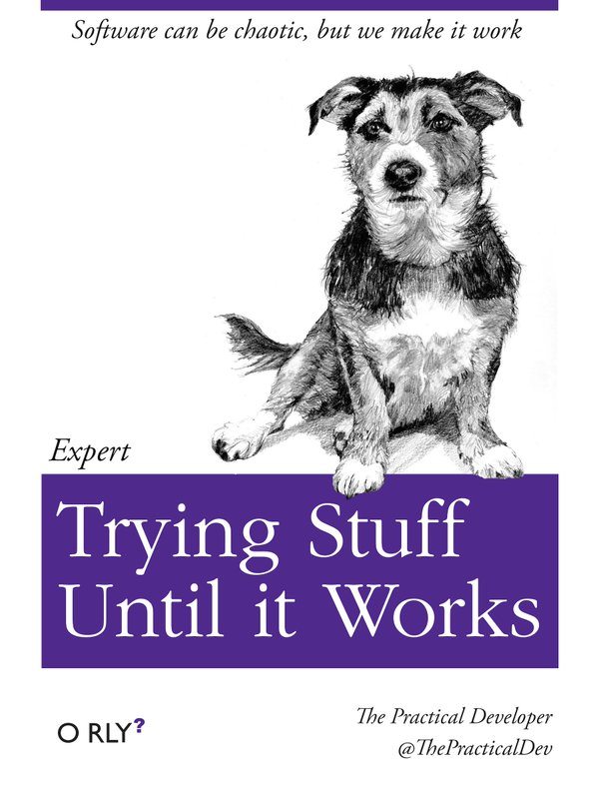
Notes:
PCP - Programming by coincidence principle. It comes in two major variations:
- Trying stuff until it works - now this is mainly applied by the more advanced programmers. They believe they understand the language so well, that they can infer APIs out of thin air.

Slide 18
HDD
Notes:
HYPE DRIVEN DEVELOPMENT
It has two main variations
- Buzzword first design
- Fear of missing out

Slide 19


Slide 20


Slide 21
HRDD
Notes:
HRDD is mainly based on the most popular tech that developer want to know. So we hire them to learn it while developing our software, and do all the possible mistakes one could do with it.

Slide 22
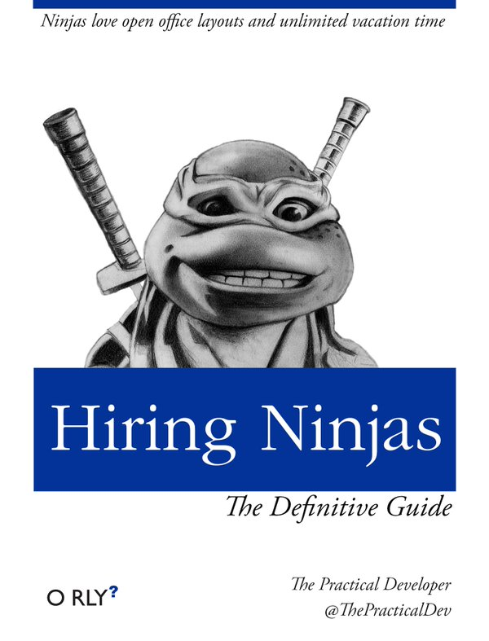

Slide 23
SDD
Notes:
Spite Driven Development (злобна ралта ☺)
- why the code is complicated and why only people ... skilled as I am can work on it
- da ne go barat juniors

Slide 24
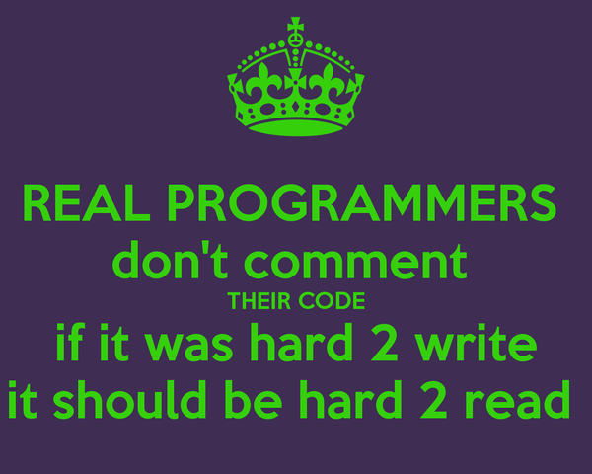

Slide 25
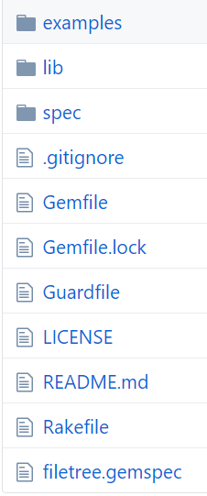

Slide 26
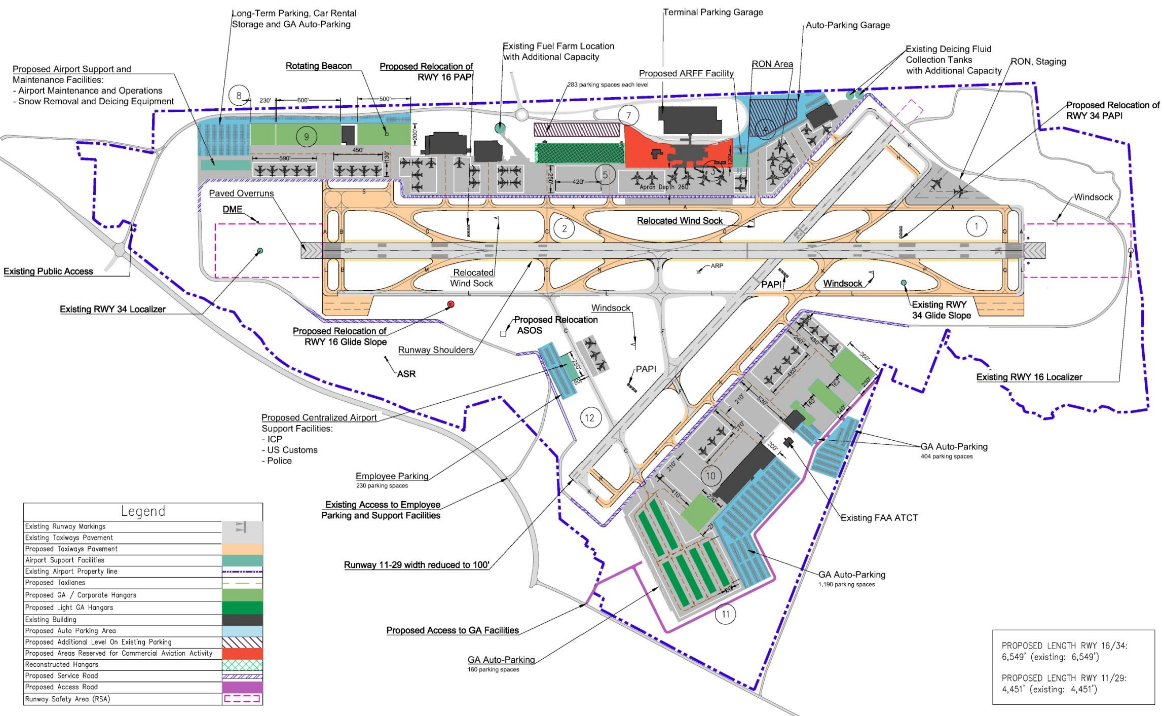

Slide 27
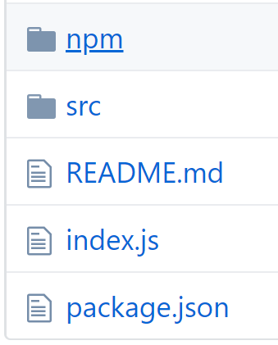

Slide 28
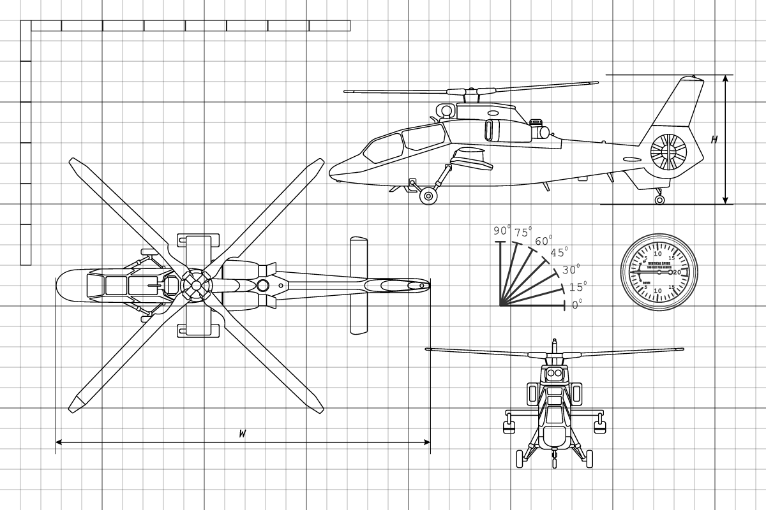

Slide 29
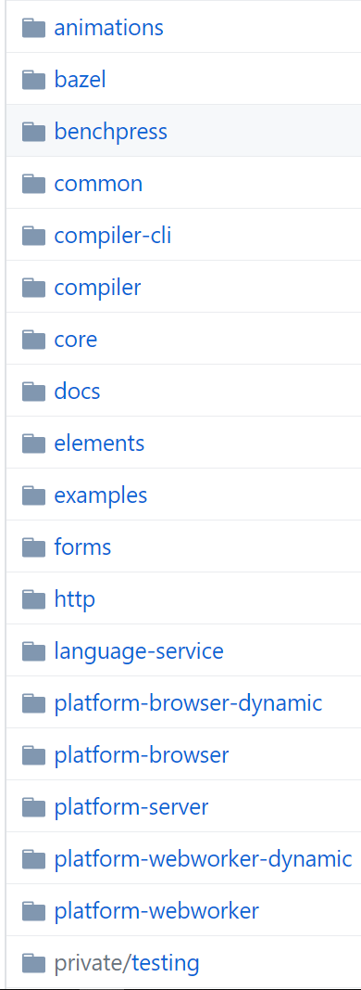
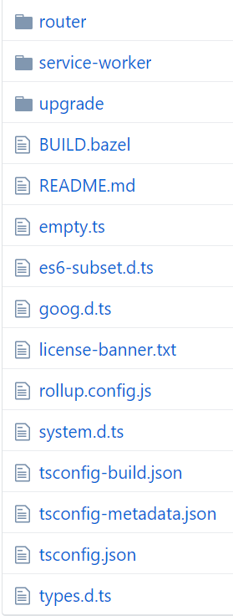

Slide 30


Slide 31
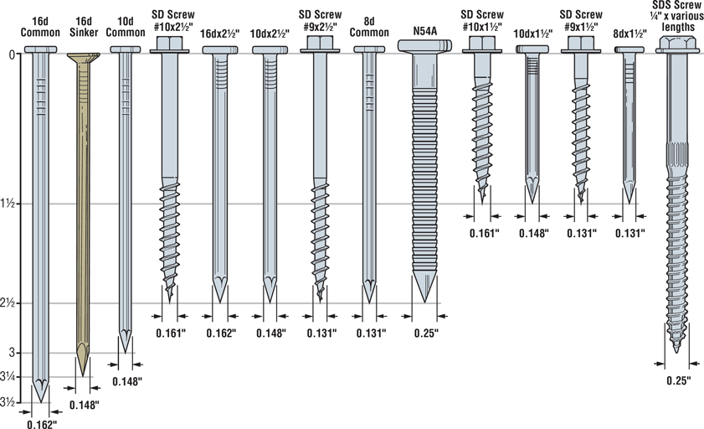

Slide 32
PVP
Notes:
Programmer vs Programator (mashinopiska)

Slide 33
Honorable mentions
Tears DD
Test Induced Design Damage
Copy Paste DD
CV DD
Shotgun debugging

Slide 34
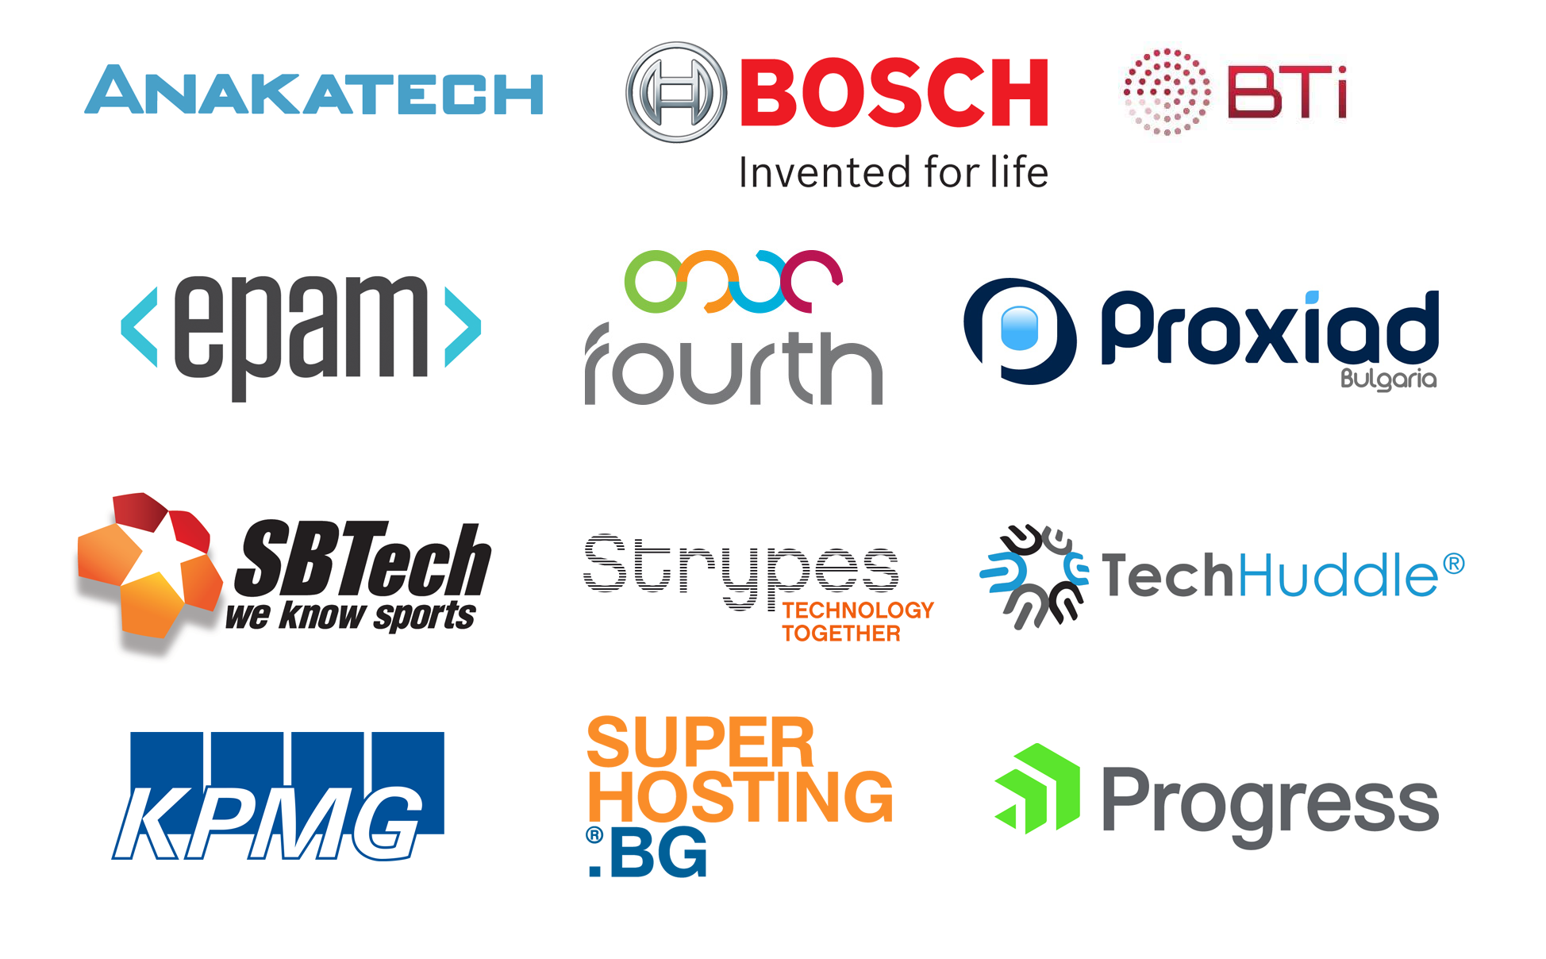
Thanks to our Sponsors:

